Slide 1
IE 260 Lecture 10: Genetic Algorithm
Il-Chul Moon
Department of Industrial and Systems Engineering
KAIST

Slide 2
Short recap

Slide 3
Encoding
Encoding step
How to represent a solution as a vector of genes
Traveling 3 cities: Total 3! cases
Ex. (Seoul, Kwangju, Daejeon)
Three possible encoding strategies
Convenience of the representation
K-ary coding
(0, 1, 2) when 3-ary coding → 012
Convenience of the future operations
binary coding
(00, 01, 10) when binary coding → 000110
Adaptation to the problem at hand
Position based coding (0 = Seoul, 1 = Kwangju, 2 = Daejeon)
(1, 2, 0) when position based coding → 120
Seoul
Kwangju
Daejeon

Slide 4
Encoding : position based coding
Adaptation to the problem at hand
Position based coding (0 = Seoul, 1 = Kwangju, 2 = Daejeon)
(1, 2, 0) when position based coding → 120
How to?
The value on position i
The city to visit next to visiting the city of i
1,2,0
1 → Kwangju is the city to visit next to visiting Seoul
2 → Daejeon is the city to visit next to visiting Kwangju
0 → Seoul is the city to visit next to visiting Daejeon
Is this any different to K-ary encoding?
In K-ary encoding: 012 == 120 == 201
Three representations are the same
In position based encoding: 012 != 120 != 201
No more wasted representations
Now, some invalid solutions exist!
Is 012 valid?
Seoul
Kwangju
Daejeon

Slide 5
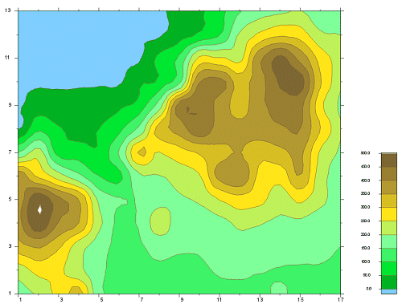
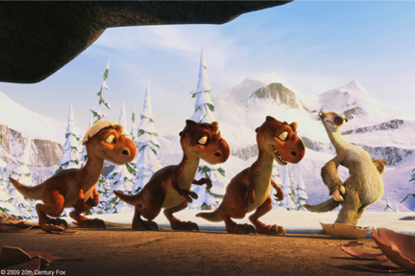
Selection step
Global Optimum vs. Local Optimum
Selection is the most delicate part of the GA
Natural selection
Selection is based upon the fitness
However, just adapting to the environment that we have is enough?
Often falls into a local optimum
To obtain a global optimum
You have to swallow some bitter tasting pills at the beginning.
Accept the inferior population
See what they eventually contribute to the solution populations
Hence, the selection is not just dropping the inferior solutions
Delicately balance
the bigger portion of good solutions
the smaller portion of bad solutions
Dinosaur in the ice age

Slide 6
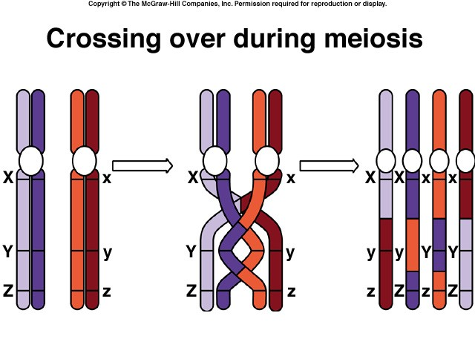
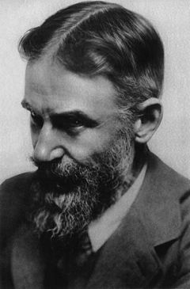

Crossover step
Through the selection step, we find two solutions to be the parent of a new solution
The new solution is generated by mixing up the genes of the two solutions
Mixing up == crossover
The best case scenario:
The new solution takes the best parts from the two solutions
The worst case scenario:
The new solution takes the worst parts from the two solutions
Hence, we need a good crossover
"Think of it!" she said, "With your brains and my body, what a wonder it would be."
George Bernard Shaw
Playwright and Co-founder of LSE
Isadora Duncan
The creator of modern dance
Shaw thought for a moment and replied, "Yes, but what if it had my body and your brains?"

Slide 7
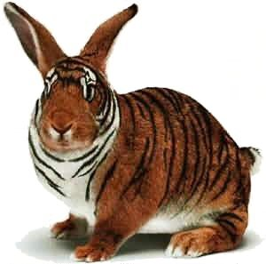

Mutation step
Problem of hill-climbing
Equal to problem of Nazi
Strong driving force in pursuing a goal
However, does not see a long-term evolution
Hence, they eliminate the diversity of population
No starting points for the new ways to improve
In GA, What-if we eliminate the diversity of the population through the selection and the crossover step?
At the end of the day, what we are going to play with is selected parents
Sometimes, you need to think outside the box
Therefore, you need a mutation
In biology, mutation is one cause of producing much stronger viruses
Many times, freak!
Few times, solution!

Slide 8
Substitution step
N = the size of population, or the number of solutions in our hands
K = the size of offspring, or the number of new solutions
We need to create a feedback system to utilize the new solutions in the iteration process
How much feedback are we going to provide?
K/N = generation gap
K/N → 1
Replacing the most of the population
Called generational GA
Dynamic, but slow
K/N → 1/N
Replace just one solution of the population
Called steady-state GA
Steady, but fast
Who to replace?
Inferior solutions? → Replacing the bottom K solutions with the new ones
Fast convergence
Parent? → Replacing the worse parent solution with the new one
Bigger diversity

Slide 9
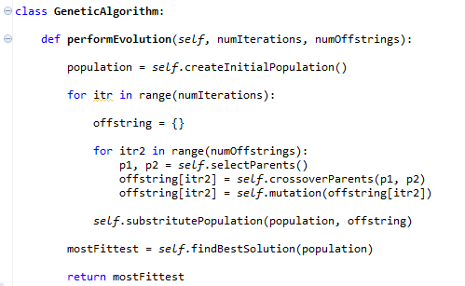
Setting up and execute
Fixed number of iterations OR stop when no more diversities OR stop when reaching a plateau OR Time constraints
Large population: more diversity, slower convergence
Small population: opposite pros and cons
Usually 20~50
Uniform random draw or shuffling: keep the diversity in the initial population

Slide 10
Offline class plan

Slide 11
To-Do: Complete Genetic Algorithm
First, you need to read the code carefully
These codes will be used to finish Homework
Complete the following methods in TravelingSalesmanProblem.py
performEvolution
Look for the appropriate method to perform the genetic algorithm
calculateTotalDistance
Iterate the genotype of the solution to calculate the distance
CalculateDistance
Complete the method considering the mathematical formula

Slide 12
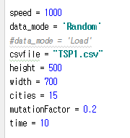
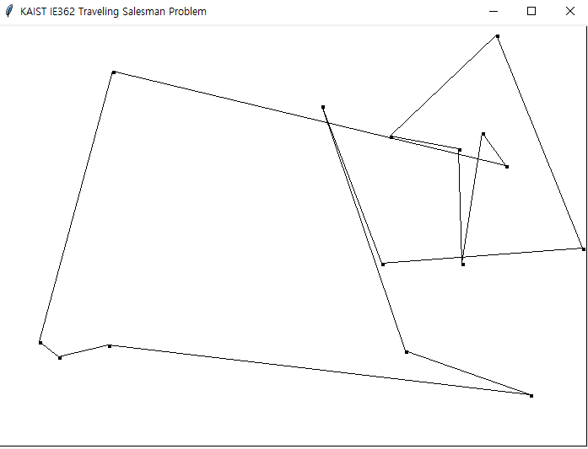
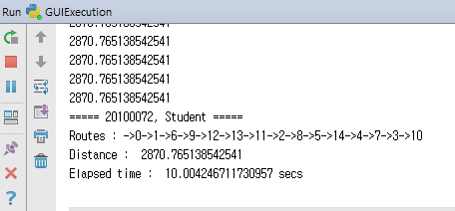
Expected Result
Genetic Algorithm
Settings
Execute “GUIExecution.py”
Visualize the genetic algorithm process
Execute “TSPExecution.py”
Console only result

